Slide 1
RecoveryOhio Advisory Committee
State Opioid Response - SOR 3.0 Update
Lori Criss, Director of OhioMHAS
June 14, 2022

Slide 2
Purpose of the SOR 3.0 Funds
Focus on building an Integrated Behavioral Health System Continuum of Care for individuals with OUD, stimulant use disorder, tobacco/nicotine dependency and Co-Occurring Disorders.
The aim is to build on a community system of care (prevention, early intervention, treatment and recovery support) that emphasizes service integration between physical health, emergency health care, behavioral health care, criminal justice and child welfare.
Notes:
On this slide, you can see that Congress has authorized the use of theses funds beyond OUD. Ohio will continue to use these funds to drive statewide leadership through MHAS and local planning through ADAMH Boards and broad community partnerships for implementation of full system of care.

Slide 3
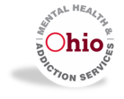
State Opioid Response Grant 3.0
Application due 07/18/2022
Requires a needs assessment and overdose reduction strategic plan
Project start date of 9/30/2022
Estimated award for Year 1 of $97,354,086
Project Period of 2 years
Notes:
With ROAC today, I want to focus on the needs assessment and the overdose reduction strategic plan. Under the leadership of RecoveryOhio, OhioMHAS is leading the work on prevention, treatment, and recovery. ODH is leading the work on harm reduction. DPS is leading the work on interdiction. Interdiction is not funded by SAMHSA and SOR, but Ohio considers all five areas critical in ending the addiction crisis for our state.

Slide 4
SOR 3.0
Needs Assessment
The scope of OUD and substance use disorders and overdose mortality in recent years
The strengths, unmet service needs, and critical gaps in Ohio’s service system across diverse racial, ethnic, geographic, and other demographic groups
Areas where opioid and stimulant misuse, substance use disorder, use of emergency medical resources for substance use such as hospitalization, and overdose are the most prevalent
The number and location of opioid treatment providers in the state, including Opioid Treatment Programs (OTPs) as well as DATA-waivered office-based opioid treatment providers
All existing activities and their funding sources in the state that address opioid and stimulant use prevention, harm reduction, treatment, and recovery activities and remaining gaps in these activities
Naloxone distribution and saturation plan
Ohio has established data collection strategies for required elements of the needs assessment.
ODH Mortality, NSDUH, Publicly-funded Substance Use Disorder Billable Services (Claims), Ohio Substance Abuse Monitoring Network (OSAM), Waiting List, Emergency Department Visits for Suspected Drug Overdose (EpiCenter), OhioMHAS program and regulatory data, OAARS, PROFOUND Study and partnership with ODH and OSU
Notes:
This is a new requirement. It goes beyond the needs statement to a statewide needs assessment. Ohio is in a good position for this work, and we are relying on robust existing datasets from multiple sources to assess current need and build our strategies for this round of SOR.

Slide 5
SOR 3.0
Strategic Plan
Identifying the most salient strategic plan objectives based on needs assessment, existing data sources, stakeholder input, and established plans.
Reviewing various data sources and plans on prevention, harm reduction, treatment, and recovery in Ohio and gathering input from stakeholders to complete needs assessment
Including recommendations from the State Health Improvement Plan, Ohio Overdose Prevention Network, the OhioMHAS Strategic Plan, Cultural and Linguistic Competency Plan, Community Plans, and RecoveryOhio
Notes:
Relying on existing datasets and goal-setting consensus work established through broad community planning processes with the ADAMH Boards, state and local health departments, our diversity and cultural competency work, and our strategic plan.

Slide 6
DRAFT
SOR Strategic Plan Goals Draft as of June 12, 2022
Reduce Unintentional Overdose Deaths (SHIP)
Increase Access to Addiction Treatment (SHIP)
Increase Recovery Supports (SHIP)
Improve dissemination and utilization of surveillance data (OPN)
Support responsible prescribing practices (OPN)
Promote harm reduction policies and practices(OPN)
Promote the adoption and enforcement of model, evidenced-informed policies for overdose prevention (OPN)
Drive innovation to ensure access to culturally responsive, trauma- informed, prevention, treatment and recovery services for all ages (MHAS)
Strengthen and expand strategic collaborations and partnerships (MHAS)
Prevent youth alcohol and drug use (SHIP)
Notes:
These are the high-level draft strategic plan goals as of today. They are pulled from existing plans informed by Ohioans, and these plans also have specific strategies to achieve these goals. As we continue to refine the needs assessment and gather input from stakeholders, the objectives and activities under these goals will be finalized.

Slide 7
Complete Link: https://www.surveymonkey.com/r/7X26PHF
Email to the SOR 3 mailbox: SOR3@mha.ohio.gov
Due by June 20th at noon
SOR 3.0 Recommendations Survey
Notes:
Today, our department hosted an informational session providing details on an opportunity for our partners to add perspective to the assessment and strategic planning that is underway. Through this survey, partners are urged to make recommendations on what’s working in local communities that should continue and what else is needed to close gaps and improve Ohio’s outcomes

Slide 8
Data on Addiction in Ohio

Slide 9
Top 10 States by Age-Adjusted Rate of Unintentional Drug Overdose Death, 2020
Source: Centers for Disease Control and Prevention, National Center for Health Statistics.
Accessed from CDC WONDER on 02.11.2022.
Notes:
Ohio is still ranked among those states with the highest rate of overdose deaths. The work before us with this SOR grant and other RecoveryOhio strategies remains urgent and a top priority for Governor DeWine.

Slide 10
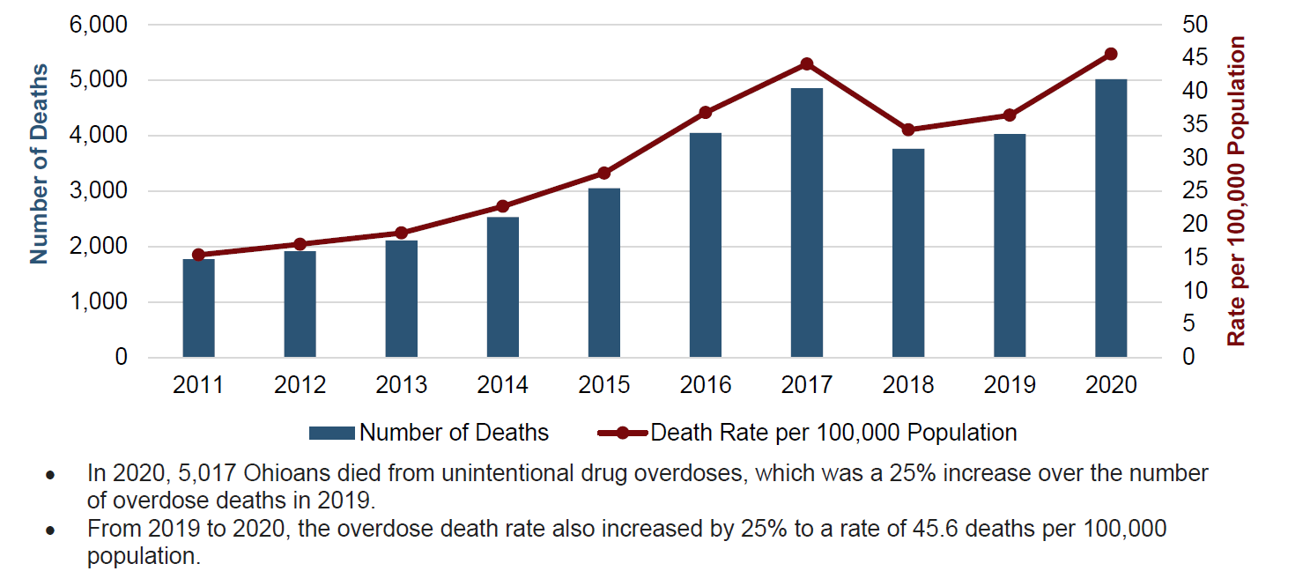
Number and Age-Adjusted Rate of Unintentional Drug Overdose Deaths
by Year, Ohio, 2011-2020
Source: ODH, Bureau of Vital Statistics. Includes Ohio residents who died due to unintentional drug poisoning (underlying cause of death ICD-10 codes X40-X44).
Notes:
Deaths continue to increase in Ohio, though the rate of increase is slowing in Ohio more rapidly in the U.S. as a whole.
Illicit fentanyl or fentanyl analogs were involved in 81% of 2020 overdose deaths in Ohio, often in combination with other drugs.

Slide 11
At-Risk Ohioans
High-risk for overdose death:
In 2020, Black non-Hispanic males had the highest drug overdose death rate in Ohio compared with other sex and race/ethnicity groups.
Residents of highest-risk Appalachian counties
High-risk for suicide:
Youth, ages 10-24
Males, ages 25-59
Non-Hispanic Black Ohioans
Veterans and military members
Residents of highest-risk Appalachian counties
Notes:
Unintentional drug overdose deaths increased for all racial/ethnic groups in 2020, though at a higher rate for Black and Hispanic Ohioans. Rural and Appalachian Ohioans have higher rates of overdose and suicide deaths, and males in all communities and of all ages are particularly high risk.

Slide 12
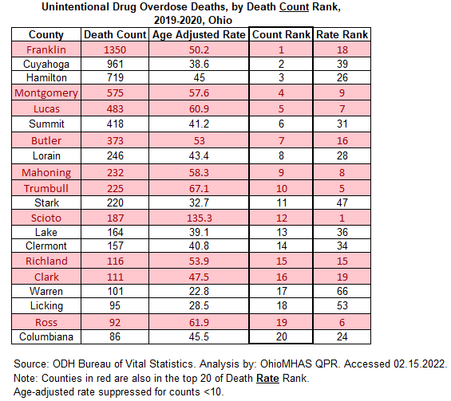
Notes:
This slide and the next look at the top 20 counties with overdose death numbers and rates. Those counties highlighted in red are in the top 20 for both rate and count.

Slide 13
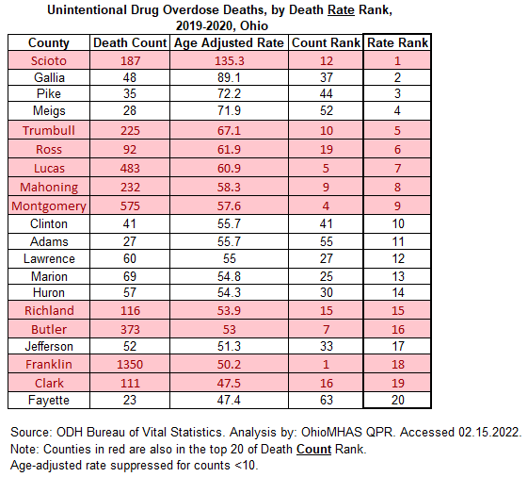

Slide 14
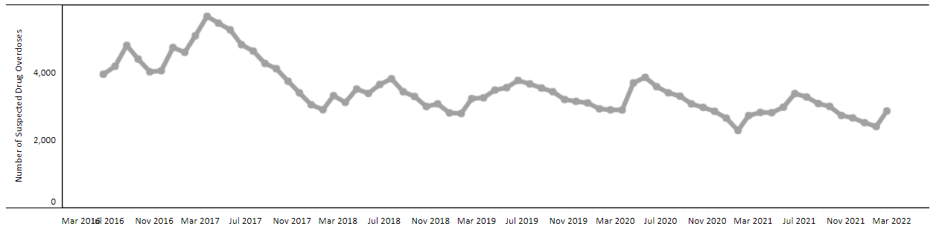
Emergency Department Visits for Suspected Drug Overdose Among Ohio Residents Ages 11 Years and Older
Source: EpiCenter, Ohio Department of Health
Notes:
This could be driven by the outreach efforts making naloxone more available in communities, and overdoses being reversed in the community with the person denying transportation to ED.

Slide 15
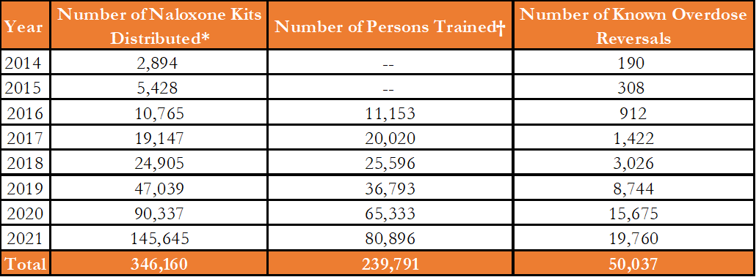
Annual Project DAWN Data, Ohio, 2014-2021
Source: Project DAWN Monthly Distribution Log.
*Number of naloxone kits distributed include naloxone funded by the Ohio Department of Health and other funding sources. †Number of persons trained was not collected in 2014 and 2015.
Notes:
Over 50,000 known overdose reversals in Ohio, including over 35,000 reversals just in the past two years, and over 44,000 since 2019.

Slide 16
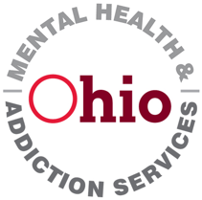
SOR Outcomes to Date

Slide 17
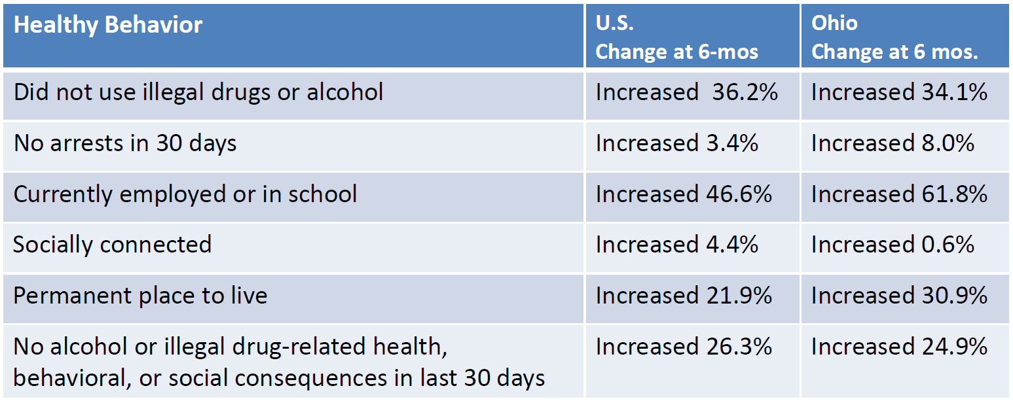
State Opioid Response SOR: Increasing Healthy Behaviors
Since 2019, 296,707 clients nationally and 31,974 in Ohio have been served through the SOR grant programs.
Source: SPARS data extracted 04.24.2022. Analysis by SAMHSA
Notes:
Ohio is performing consistently or above national outcomes. There are areas for continued focus and improvement, and we’d like to see increased outcomes in every area measured. Outcome performance will be included in our planning for this round of funding.

Slide 18
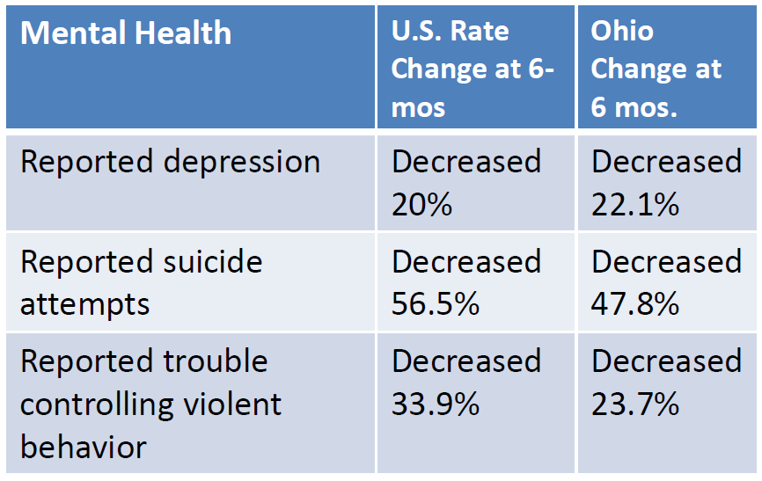
SOR: Improving Mental Health
Source: SPARS data extracted 04.24.2022. Analysis by SAMHSA

Slide 19
More Information

